Slide 1
Analysis on Traffic Violation Data
Team Outliers
Kim Minsu, Kim Won Hyun, Liu Siyuan
Zhang Linghan, Tan Chin Won

Slide 2
Background & Motivation
254 million registered vehicles in the Unites States as of 2012
Increasing traffic violations
Helping government reduce traffic violations

Slide 3
Our Dataset
Traffic violation data in the Montgomery County, Maryland
About 680000 entries from 2012 to 2015
The dataset includes information about: - date, longitude, latitude, belts, fatality, alcohol, vehicle’s model, race, gender and etc.

Slide 4
Questions
Q1 : How are the traffic violations distributed?
Q2 : What are the differences in characteristics on traffic violations between genders?
Q3 : What is the trend of the number of traffic violations in time series?

Slide 5
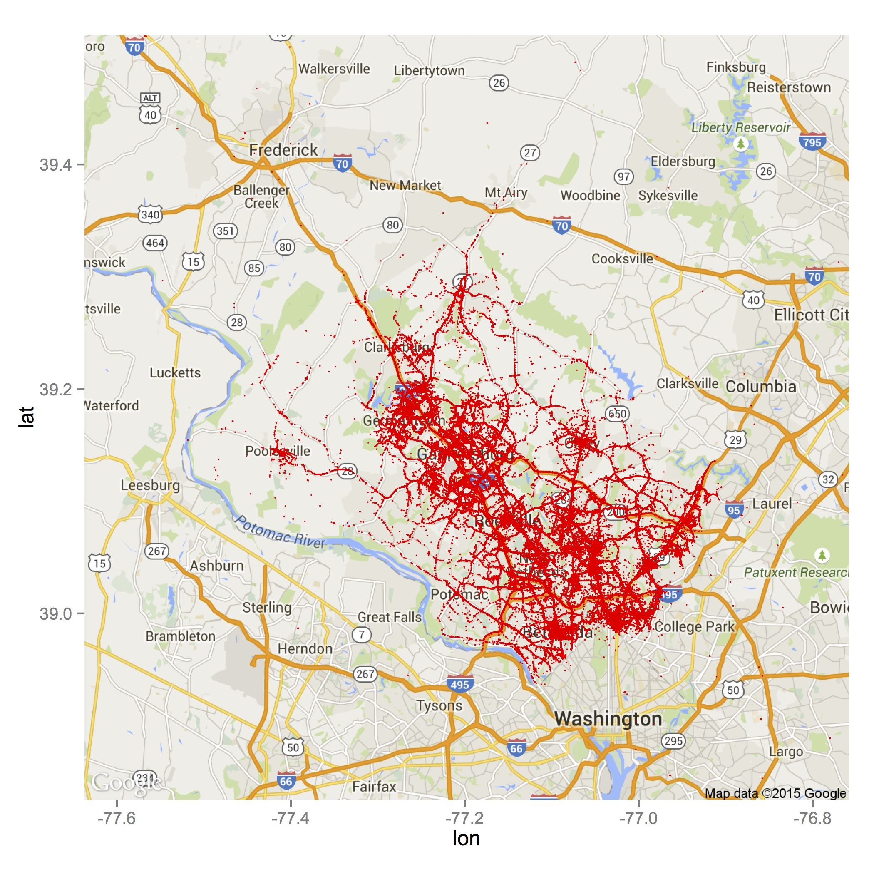
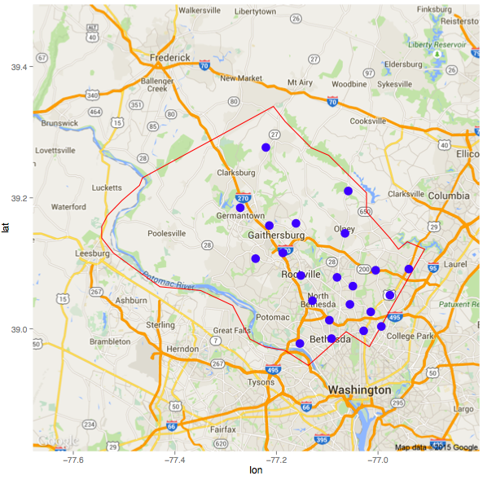
Analysis for Question 1
Methods
K-means
Results
Map Plots of violation locations
Interpretation

Slide 6
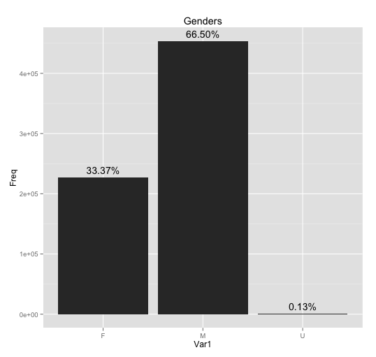
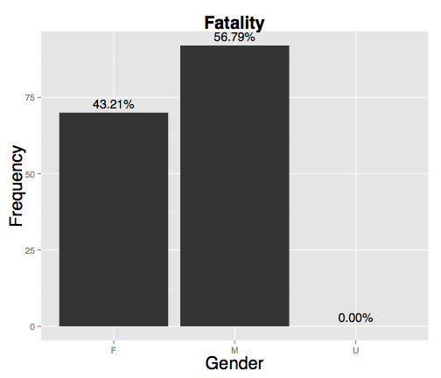
Analysis for Question 2
Violation in Total
Violation with Fatality
Methods
Results
Bar plots of violation count by gender
Interpretation
Gender
Gender

Slide 7
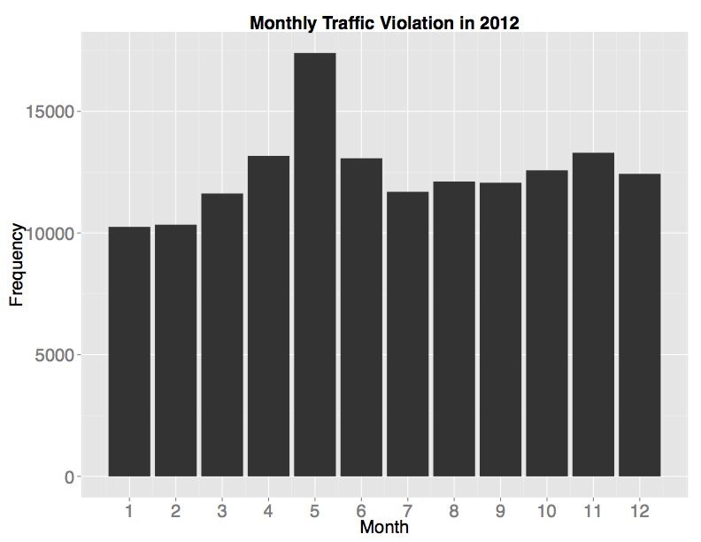
Analysis for Question 3
Methods
Student’s t-test
Linear regression
Results
Bar plots of monthly and yearly violation count
Interpretation

Slide 8
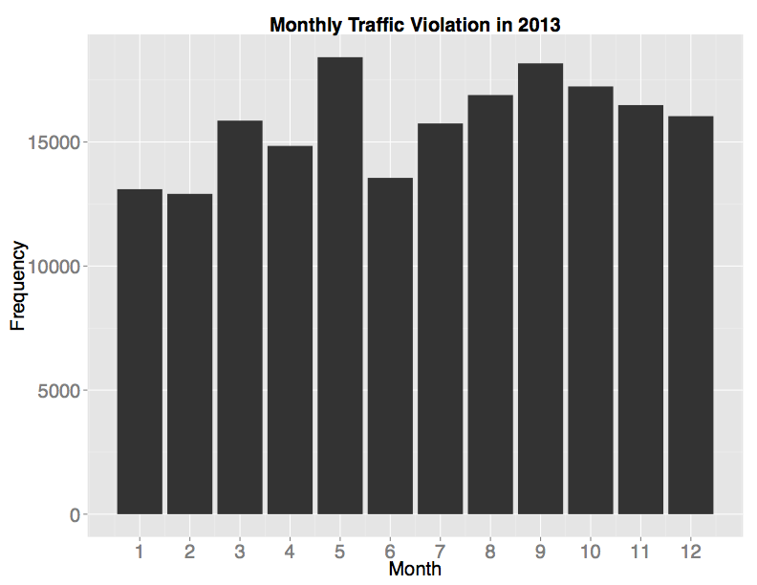
Analysis for Question 3
Methods
Student’s t-test
Linear regression
Results
Bar plots of monthly and yearly violation count
Interpretation

Slide 9
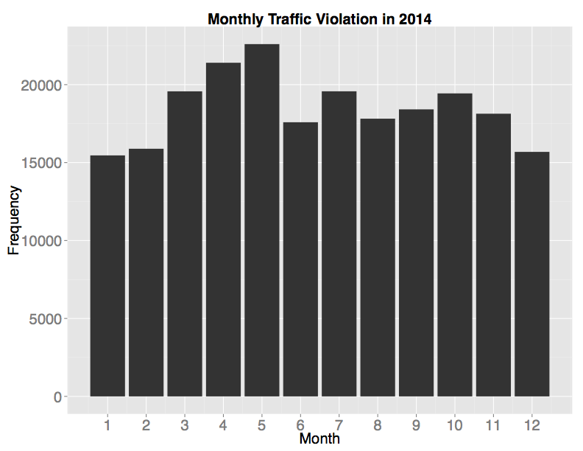
Analysis for Question 3
Methods
Student’s t-test
Linear regression
Results
Bar plots of monthly and yearly violation count
Interpretation

Slide 10
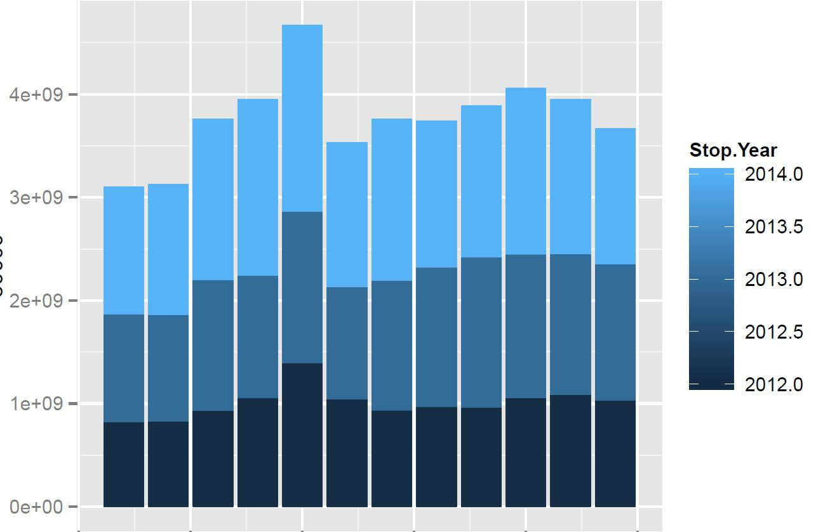
Analysis for Question 3
Stacked Monthly Traffic Violation
Methods
Student’s t-test
Linear regression
Results
Bar plots of monthly and yearly violation count
Interpretation
Frequency

Slide 11
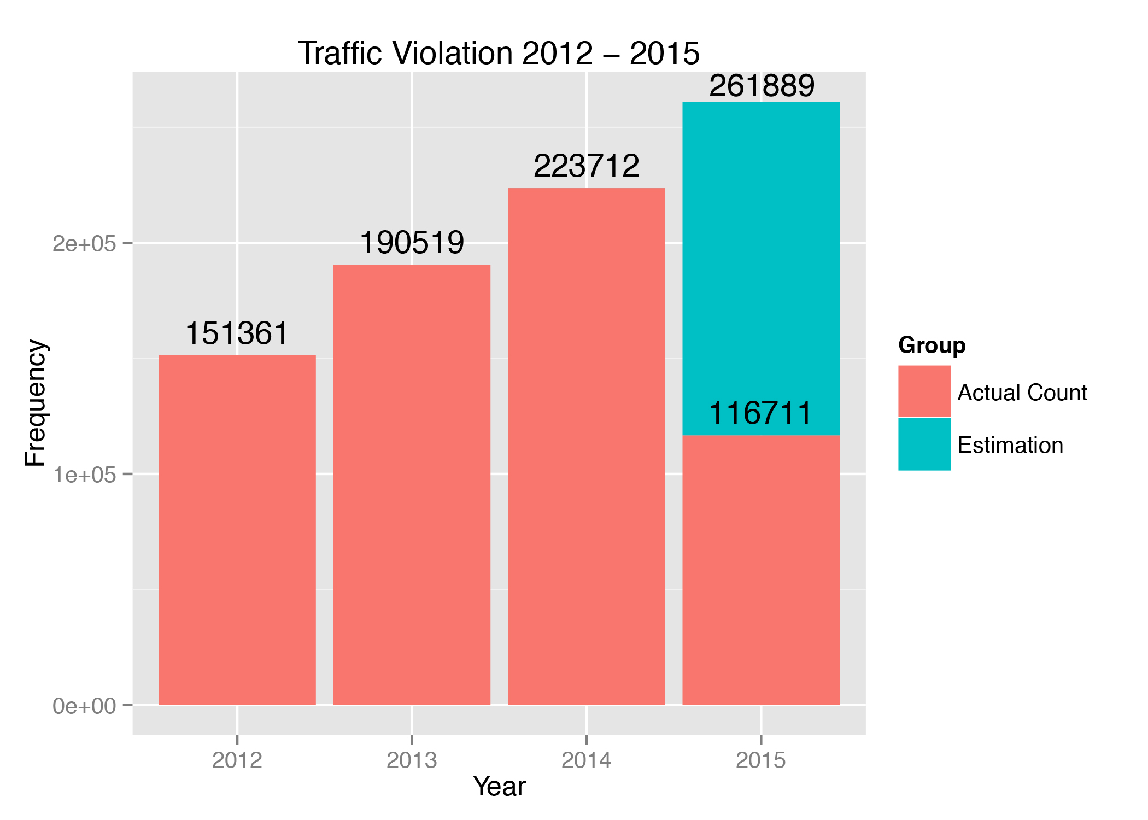
Analysis for Question 3
Methods
Student’s t-test
Linear regression
Results
Bar plots of monthly and yearly violation count
Interpretation

Slide 12
Conclusion
Most traffic violations happen at crossroads
Female drivers have a higher change of cause fatality in traffic violations
Traffic violations are increasing at a constant high speed

Slide 13
Future Directions
Relation between road conditions and traffic violations
Relation between types of violations and violation locations

Slide 14

Thank you for your time
Team Outliers

